Slide 1
NCBRTL
Becky Garrett, MS, LRT, CTRS, FDRT
NCBRTL Executive Director

Slide 2
Prior to 2005
Started out as a Certification Board(NC-TRCB) 1987-2005
  Title Protection, could not use TRS or call yourself a Therapeutic Recreation Specialist without being certified

Slide 3
Chapter 90C
NC Recreational Therapy Licensure Act
Effective Oct 2005
Changed purpose, function and compliance

Slide 4
Agreed to self monitor RT in NC
Set competencies(educational requirements, internship and exam passage)
Review continued competency through continuing education
Discipline any non-compliance with the law issues
Protect public by following set professionals standards, (SOP and Code of Ethics)

Slide 5
Chapter 90C
The law sets basic authority, definitions

Slide 6
NCBRTL Duties
Set competencies
Issues Credentials
Monitors and Regulates Practice

Slide 7
NCBRTL Has Two Functions
Awards credentials (Credentialing Board)
Regulates Practice by monitoring for compliance (Regulatory Board )
Investigates and issues sanctions for malpractice and lack of compliance to Chapter 90C, Code of Ethics, SOP

Slide 8
Administrative Rules
21 NCAC 65
NC Board of Recreational Therapy Rules
Spells out specifics to the law
Ex. Ed Requirements
Ex .0601 Continuing education Requirements
Ex Fees

Slide 9
WHY?
Protects public by ensuring practitioners properly educated, trained and practice ethically
By:
Establishing guidelines and requirements
Monitors practice
Monitors practitioners for “compliance”

Slide 10
Monitoring Practice
If you have any Disciplinary Actions taken, you must notify the Board withing 72 hours
If you want to file a complaint on another LRT, complete Incident/ Complaint Form online

Slide 11
Employment
IF you take position before license is issued
  DO NOT PRACTICE RT!!!
  No matter what your job title is.
    Do not do ANY Part of the APIE Process
    This will delay you getting your license, you will have to report job duties on Employment Form

Slide 12
Use of “CTRS”
NC Department of Justice views use of “CTRS” is implying you are credentialed to Practice RT in NC and you are not…YET
So DO NOT use “CTRS” before your license is issued!!!!
Do not use in your Email signature
Do not use on job applications, resume
DO NOT PRACTICE/WORK before LICENSE IS ISSUED

Slide 13
Compliance
Obtain License
01
Maintain License off year of Renewal due
02
Renew every two years with continuing education to remain up to date with healthcare and RT
03
Attend Compliance and Ethics Training during first year of license
04
Comply with ATRA Code of Ethics
05
Comply With Standards of Practice
06

Slide 14
Before applying
Read Chapter 90C and the Rules
Order Transcripts
Get NCBRTL Clinical Performance Appraisal and Summary Reference Form(CPASRF) Form signed at end of your Internship. Do not leave without this completed even if you are not applying for license now.
Don’t wait for exam or transcripts start early!!!!! Open application and add as you go.

Slide 15
NCBRTL.ORG
Online applications
  Read instructions first
  If you have questions, email them all at one time
  Start early
  Hints:
  Online applications are approved first
  Online information will have to be completed at some point

Slide 16
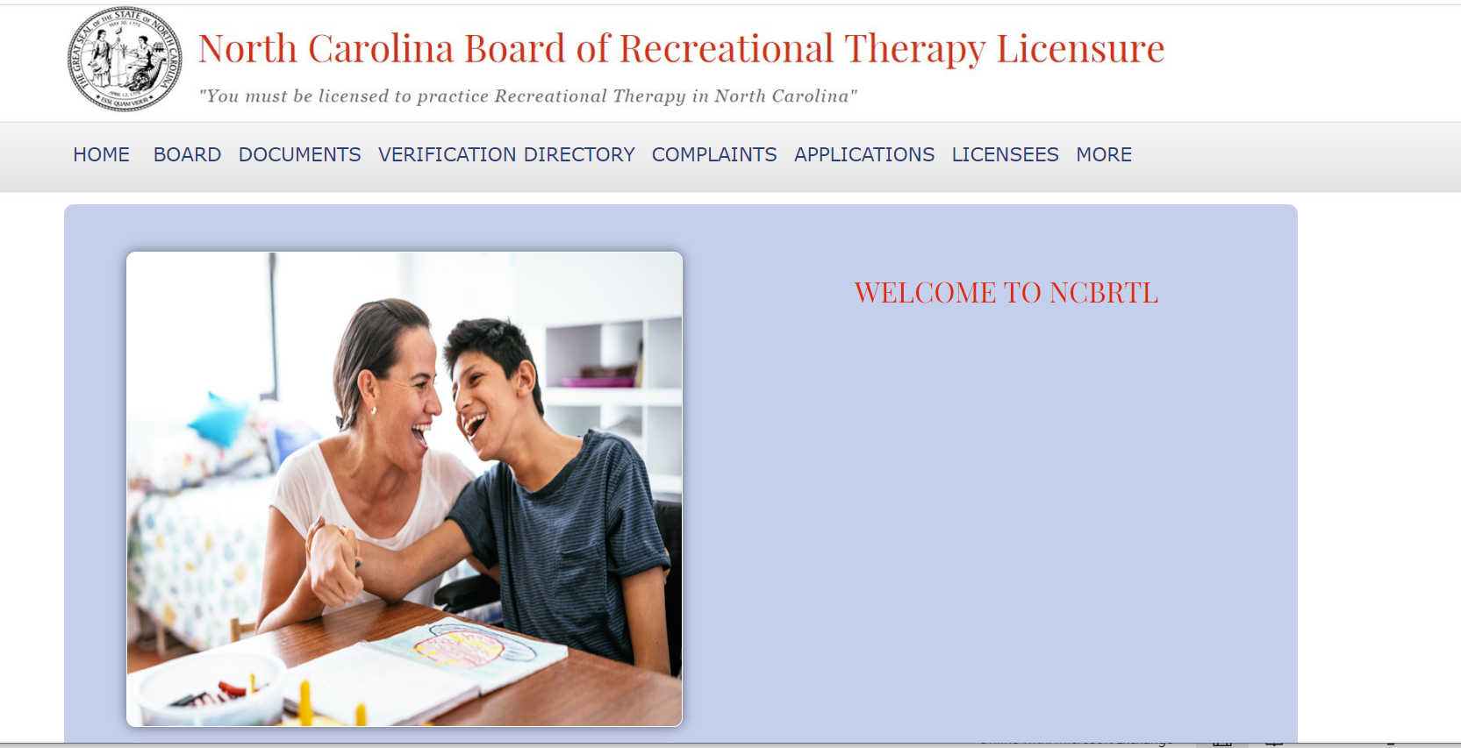
Online Application

Slide 17
Application Process
Application are issued once completed application and documents are uploaded or received by mail.
So plan ahead, apply early
Application may be submitted online, by hard copy or hybrid
Online application are processed faster

Slide 18
Review- Online PROCEDURE is faster, no deadlines
the staff reviews applications once complete with all documents received, posted on website within 48 hours
Applications with concerns are referred to the Board and may take longer

Slide 19
Log In under “Applications”
Pay for application (please notify NCBRTL if a person other than you is paying)

Slide 20
Log in Under “Applications” on the home page
Write down your user name and password for re-entry

Slide 21
Entire Application must be filled in
No “see transcripts” etc.
Yes, NCBRTL CPASRF (internship Form) is required no matter how long ago internship was completed

Slide 22
Coursework
6 RT content Course specific to Rt usually entitled RT
not general recreation courses
Anatomy and Physiology
Abnormal Psych, ex. Psychopathology
Growth and Dev Across Life span ex. Dev Psych, Birth to death
9 additional Hours in supportive courses, healthcare, human services,

Slide 23
Documents
At the end of the application you will be able to upload:
(CPASRF) Clinical Performance Appraisal and Summary Reference Form signed and completed by your Internship Supervisor.
Official Transcripts (no student copies) can be uploaded or school registrar’s office may email them to becky@ncbrtl.org
Photo Color head and shoulders –Be professional!
Proof of Exam passage, letter from NCTRC or copy of NCTRC certificate
Copy of email notification or screen shot not accepted

Slide 24
No emails
Either upload or mail in documents
NCBRTL does not accept emailed documents from applicant
School Registrar’s office may email Official Transcripts

Slide 25
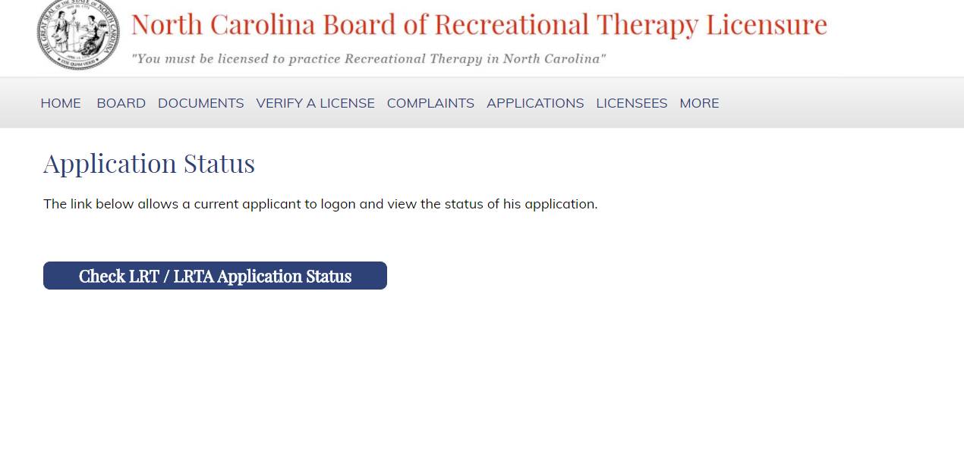
Check Your Status
Log in under “Applications”
Check Application Status
-missing items will be listed here

Slide 26
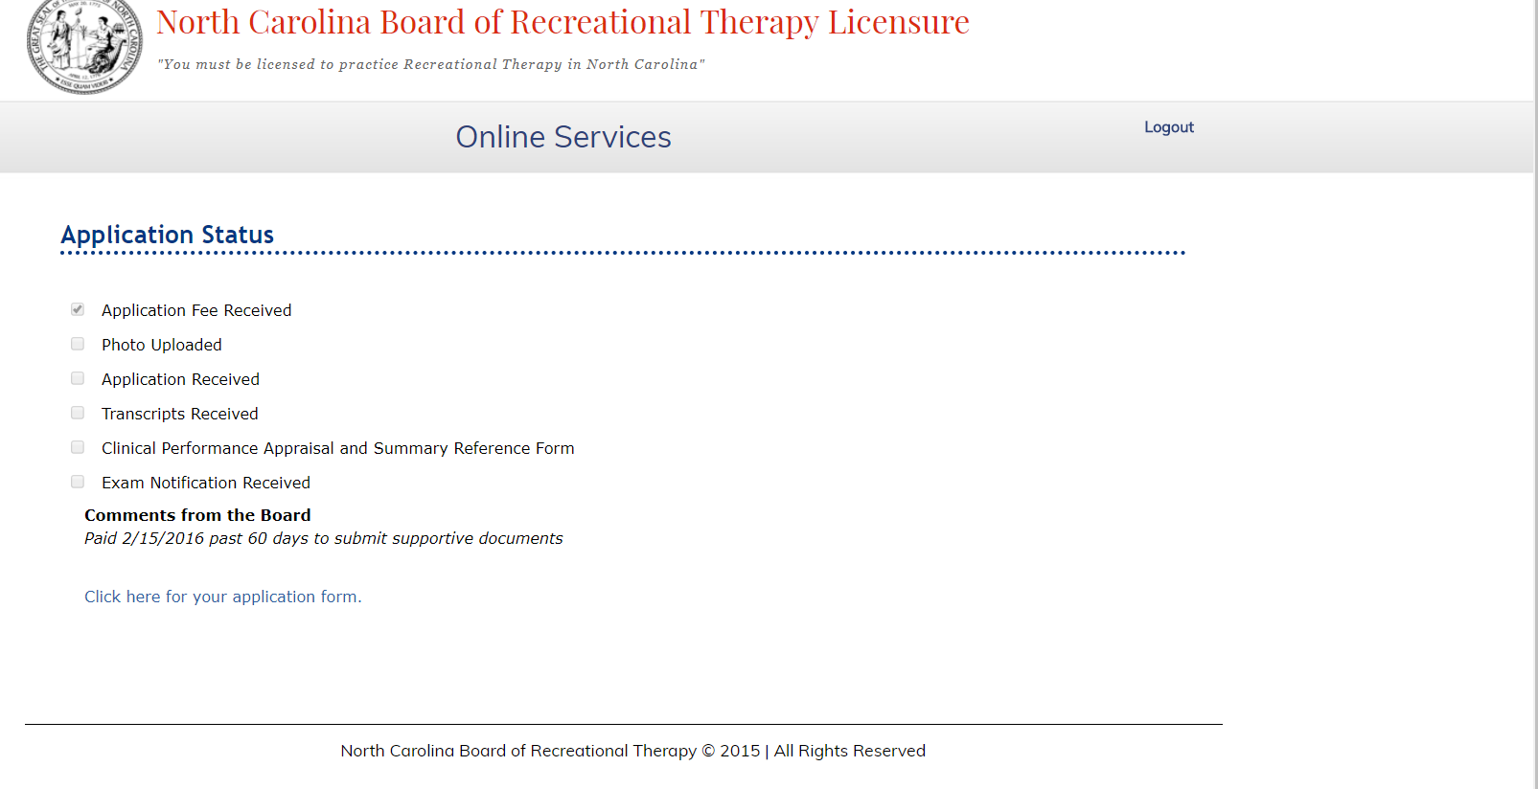

Slide 27
Review of accepted documents
See specifics for each document required

Slide 28
Exam Passage
Copy of NCTRC certificate (not screen shot of NCTRC website)
Or Exam passage notification letter from PSI
Not email from NCTRC nor a screen shot of online verification. These will not be accepted.

Slide 29
CPASRF
Not school’s, Not NCTRC’s Forms
Clinical Performance Appraisal and Summary Reference Form completed and signed by agency internship supervisor
Submit one from each supervisor is interrupted and have two sites
Can be sent separately from Internship Supervisor( agency not school supervisor)
Must have received an overall rating of 2 or above
Out of state, CTRS only ( just enter n/a for state license number

Slide 30
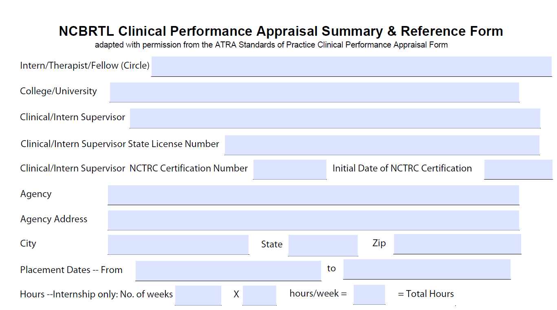
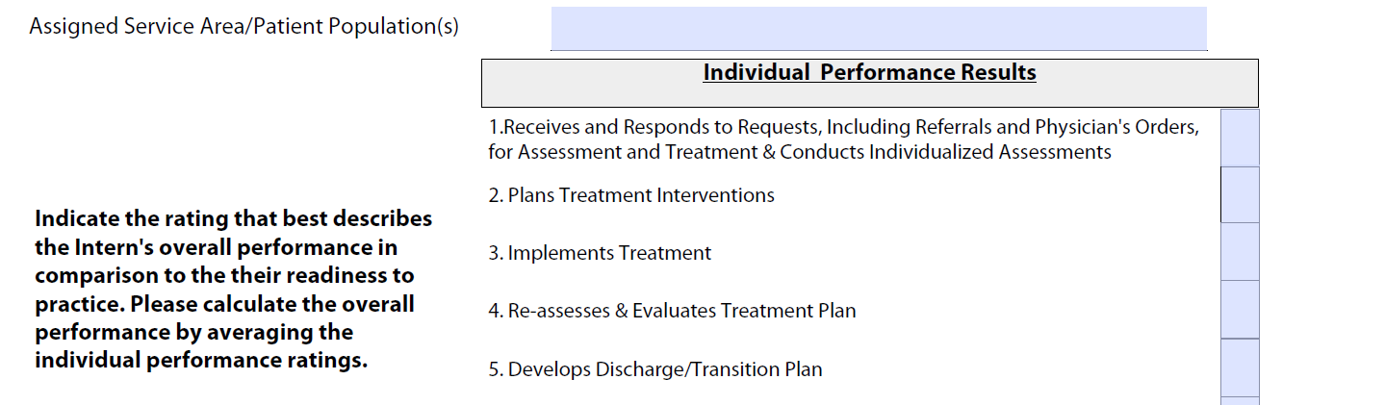
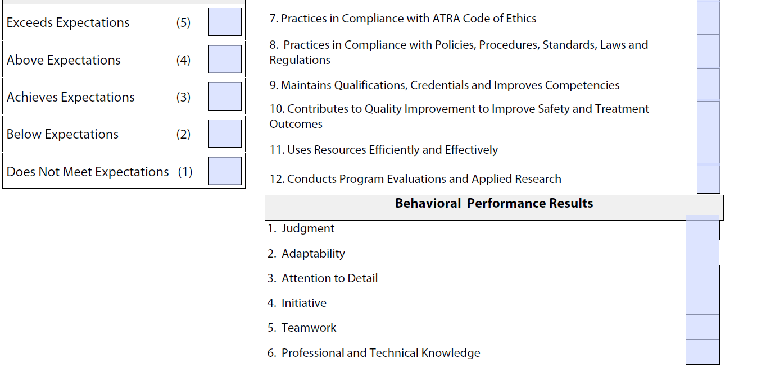

Slide 31
Photo
Upload or mail COLOR, head and shoulders, photo, (similar to passport photo) Be professional!
If mailed in, Please attach to hard copy application or write name on back

Slide 32
Official Transcripts
Degree must be awarded
Internship Course must be reflected on the transcript
All required courses must be passing or higher
Transcripts from each school where the required courses were taken
6 RT Content Courses (eff 6/1/2022)
3 hours in Anat. and Phys.
3 hours in Growth and Development across life span
3 hours in Abnormal Psych
9 additional hours in Health and Human services

Slide 33
Hard Copy Process
Completed application and documents must be mailed in (Can be sent separately)( not emailed)
  Exam Passage
  CPASRF
  Photo (color, head and shoulders)(name on back)
  Official Transcript (may be emailed from School Registrar’s office)

Slide 34
Prefer Hard Copy?
Print out under “Documents,” Forms on home page
Still will have to complete online profile after you are licensed
Hard copies take longer…so if you are in a hurry….

Slide 35
Hard Copy Payment
Payment must be a money order or cashier’s check.
NO personal checks!

Slide 36
Employment Form Online or Hard copy
Complete form (in reference to what you are doing currently in RT)
Include copy of signed Job Description
Do not reflect what you have done in the past or anticipate doing in the future

Slide 37
Common Questions?
Mail documents separately? YES
Pay online, but complete hard copy? YES
Accept emailed documents? NO (except Transcript from school)
What do I put for “NCBRTL Use”?- NOTHING that’s for NCBRTL’s use
What if Intern supervisor is not LRT (out of state) – put Nothing or N/A
What if I am not employed –Put nothing or N/A

Slide 38
Occasional Issues
Name change since graduation? Submit Name Change Form and copy of Marriage certificate or Divorce decree
Some one else pays your license fee? Sent email so that we credit your account

Slide 39
Notification
Licenses are posted online within 48 hours of Board Review
Licenses are mailed within 1 week

Slide 40
Once you are licensed
Attend NCBRTL Compliance and Ethics Training during your FIRST Year of licensure
Start earning continuing education (20 HOURS every two years)
Proudly use “LRT” credential!
Keep contact info current on website!!!!

Slide 41
NCBRTL Compliance and Ethics Training Schedule
First Friday in March
First Friday in August
First Friday in November

Slide 42
If you are not approved
Your application remains ”open” for one year
You may submit missing documents, and or additional information
ex. New test results
Course description or course syllabus of when course was taken
Documentation for name change
CPASRF rating change
Transcript for missing coursework

Slide 43
Questions?
Email:
(becky@ncbrtl.org)
Or call (336) 212-1133
Mon-Thurs 8:30-4:30

